Slide 1
Imaging techniques for Raman Spectroscopy
Arijit Pramanik
150020094
Dept. of Computer Science and Engineering

Slide 2
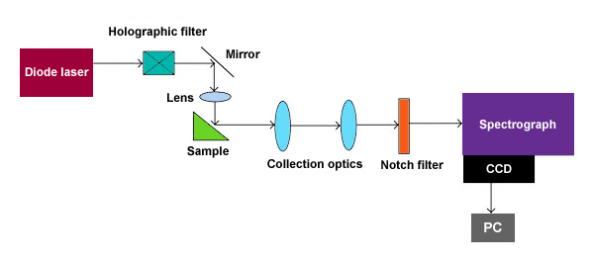
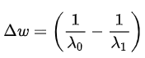
Raman spectral imaging
Used for structural fingerprint for the identification of molecules
Raman Shift :
Notes:
Named after Sir C.V. Raman, it is a spectroscopic technique used to observe vibrational, rotational, and other low-frequency modes in a system, and determine the chemical composition of molecules. It relies on inelastic scattering, or Raman scattering, of monochromatic light, usually from a laser in the visible, near infrared, or near ultraviolet range. The laser light interacts with molecular vibrations or other excitations in the system, resulting in the energy of the laser photons being shifted up or down.
Typically, a sample is illuminated with a laser beam. Electromagnetic radiation from the illuminated spot is collected with a lens and sent through a monochromator(choose a selected few out of many wavelengths). Elastic scattered radiation at the wavelength corresponding to the laser line (Rayleigh scattering) is filtered out by a notch filter, while the rest of the collected light is dispersed onto a detector. Holographic gratings are used for a high degree of laser rejection.
Raman shifts are typically reported in wavenumbers, which have units of inverse length, as this value is directly related to energy. Delta(w) is the Raman shift expressed in wavenumber, λ₀ is the excitation wavelength, and λ₁ is the Raman spectrum wavelength

Slide 3
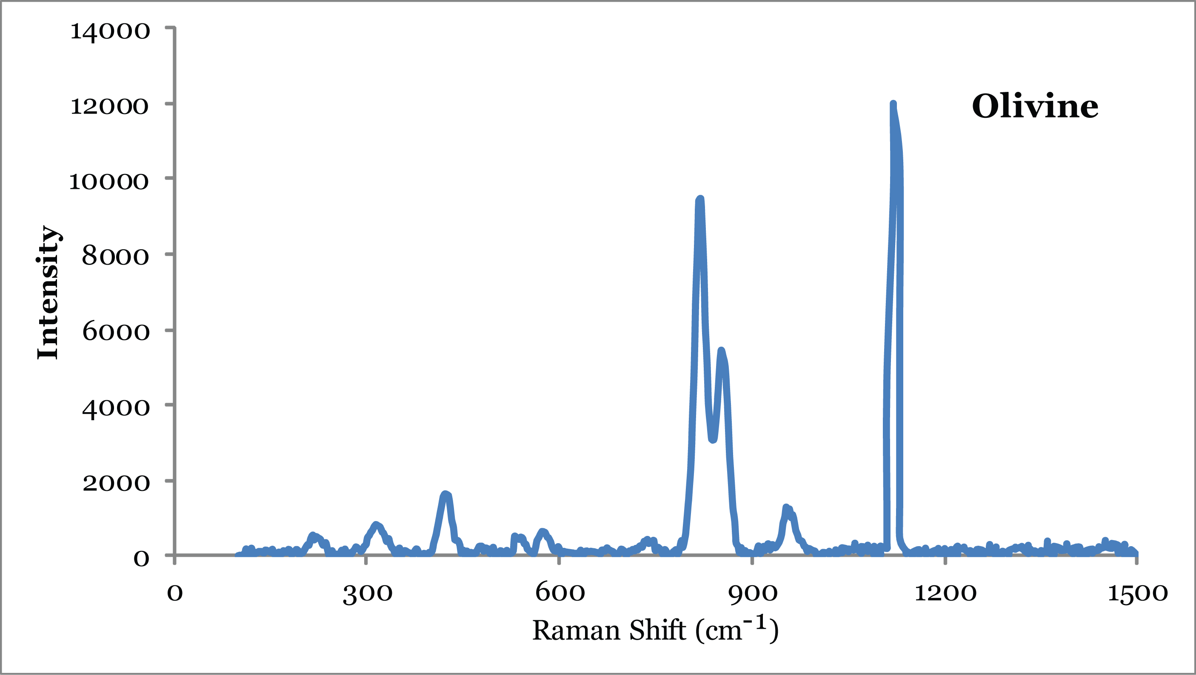
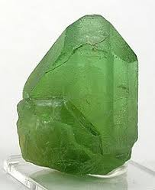
Applications of Raman Spectroscopy
Pharmaceuticals and Cosmetics
Geology and Mineralogy
Semiconductors
Life Sciences
Carbon Materials
Notes:
In the pharmaceutical industry, it helps probing blend uniformity, compound distribution in tablets, and also for contaminant identification.
For geological specimens, it helps in gauging mineral and phase distribution in rock sections in addition to gemstone and mineral identification.
It helps in determining purity, alloy composition and superlattice structure for semiconductors
In the field of medicine, this helps to analyze bio-compatibility, drug-cell interactions and characterization of bio-molecules
In this era of carbon materials, it helps to analyze purity and electrical properties of carbon nanotubes

Slide 4
A few drawbacks..
High sample acquisition time
Higher resolution images
High desired spectral quality
Some materials have extremely low Raman scattering properties
Raman signal is weak
Only around 1 in every 1 million photons is Raman scattered
(Ref : http://spie.org/newsroom/combine-and-conquer)
Shot noise from fluorescence may further reduce SNR
More scans of the sample
Longer exposure time
Higher sample concentration
Notes:
The time taken to acquire a Raman spectral image depends on parameters like size of the image, number of pixels to be sampled, and the per pixel acquisition time, (which itself depends upon the intensity of the sample’s components), and the spectral quality required.
Sometimes, materials may have extremely low Raman scattering properties. Shot noise from fluorescence may obscure the Raman signal. In such cases, quantitative analysis is not possible when the signal-to-noise ratio (SNR) is low beyond a certain threshold.
CCD detectors often have an inherent dark noise, optic response. A desired threshold of high signal to noise ratio is often required, which might require higher sample concentration which might be infeasible, multiple scans, more exposure time or other forms of denoising and pre-processing.
// Sometimes, on absorbing the laser radiation, molecules get excited to higher energy levels, and emit fluorescence on returning to the ground state. This is very strong compared to the weak Raman signal, and has a broad and flat spectra, which is quite likely for many samples, or in case of sample impurities.

Slide 5
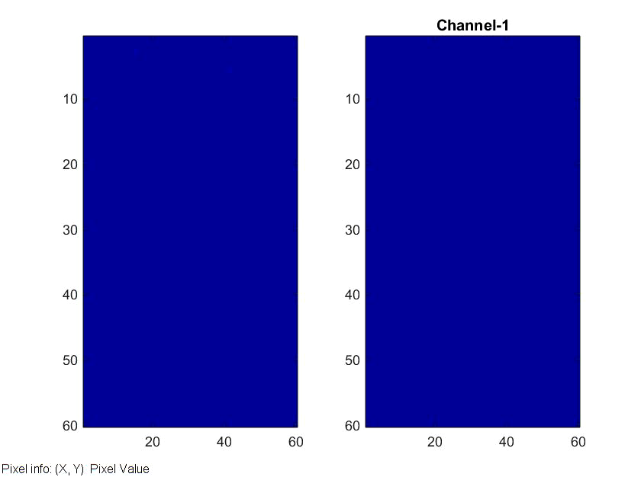
Our innovation…Compressed Sensing
Given Raman shifts for only a fraction of the entire sample, we reconstruct the Raman shifts for the missing pixels using information from the spectra of the randomly chosen pixels
Notes:
Generally, the input image comprises of typically more than 200 channels, corresponding to each pixel. A typical recorded spectral image would be of size 101 X 101 X 253. Sampling 50% of the pixels in the input image will help save a lot of time and effort, hence acquisition time.

Slide 6
Advantages
Sampling rate : A sampling rate of 50% will require only half of the original acquisition time
Can be used for obtaining higher spectral quality for the recorded fraction of pixels
Complete reconstruction done in software. No expensive hardware like coded apertures required
(Ref : Colored Coded Aperture Design by Concentration of Measure in Compressive Spectral Imaging –Arguello H. and Gonzalo R.)
Random sampling : No complicated sampling heuristic
Lesser scans help to preserve sample integrity over time
Denoising of the input image
Notes:
We can choose to record the spectra at a variable number of pixel locations. Different sampling rates are suitable for different applications. A sampling rate of 50% will require only half of the original acquisition time.
We can devote the same amount of time to record spectra of certain pixels more accurately.
This does not rely on expensive setups or additional hardware like coded apertures, and is completely done in software.
There is no sampling heuristic required, and random sampling works well.
These lesser number of scans will also help to preserve the health of the sample over time.
This could also help in denoising of the input image.

Slide 7
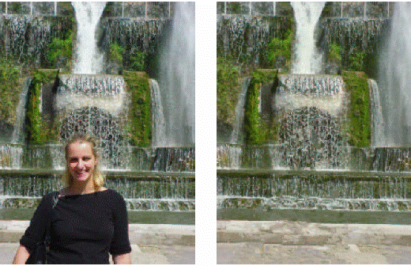
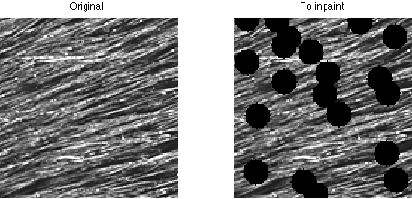
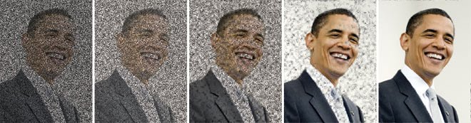
Proof-of-concept : Inpainting
Inpainting is the process of reconstructing lost or deteriorated parts of images and videos
It is generally used for :
Removing red-eye, datestamp from photographs
Replacing corrupted pixels lost in transmission
Removing logos in videos
Structural inpainting
Textural inpainting
Notes:
Inpainting is the process of reconstructing lost or deteriorated parts of images and videos. In the digital world, inpainting (also known as image interpolation or video interpolation) refers to the application of sophisticated algorithms to replace lost or corrupted parts of the image data (mainly small regions or to remove small defects).
It has been very successful in today’s world and helps in removal of the date of photographs, or red-eyes resulting from camera flashes. It can help in restoring corrupt pixels in transmitted satellite date, or even removing watermarks or logos from images or video frames.
Inpainting can be structural or textural in nature or a combination of both. The former uses geometric approaches for filling in the missing region, while the latter tries to improve upon the inability of structural inpainting to restore local texture information in missing regions.

Slide 8
Problem Statement
Given an image of m x n x L, where, for only a fraction, f of the m x n pixels, the Raman spectra is recorded, for all the given N channels,
Our goal is to reconstruct the entire image of m x n x L using Non-Negative Matrix Factorization (NMF) or Non-Negative Sparse Coding (NNSC), modeling the problem as a form of inpainting
Notes:
For the given randomly sampled input image, we try to reconstruct it its entirety using Non-Negative Matrix Factorization, or a variant of the same thing, Non-Negative Sparse Coding

Slide 9
NMF & NNSC
Given matrix V, V = WH, subject to v_{i} >= 0, w_{i} >=0, h_{i} >=0
Usually, NMF finds applications in fields of astronomy, computer vision, audio signal processing, recommender systems and bioinformatics
NMF
Introducing a sparsity prior for the NMF error minimization function,
min_{W,H} ||V – WH||_{F} + λΣf(H_{ij}), W >= 0, H >= 0
NNSC
Notes:
Let V be a matrix, and let it be the product of two matrices W, H with the additional constraint that all the three matrices have no negative elements. The no of columns of W, i.e. the no. of columns of H depend upon the application. We can find the matrices W, H from V using the following error function.
Non-negative sparse coding ensures that one of the matrices is sparse, using only a few significantly non-zero entries. Combining the goal of small reconstruction error with that of sparseness, one can arrive at the following objective function to be minimized. More on this in the later slide

Slide 10
Applying NNSC to our problem…
Blind Dictionary Learning :
Extract image patches of size psz x psz.
Let N be the total number of image patches under consideration
Let L be the total number of channels involved
Arrange image patches into columns of matrix X [(psz*psz*L) x N]
Linear decomposition of X as X ~ AS
A [(psz*psz*L) x l] represents the dictionary matrix, where each column depicts a feature vector
S [l x N] represents the coefficients matrix, where each column represents coefficients of each basis vector in the input vector
Notes:
We use NNSC for the purpose of blind dictionary learning, where we extract patches from the image in blocks of psz * psz and reform them to (psz*psz*L) X 1 column vectors to form the matrix X of dim (psz*psz*L) X N.
Linear decomposition of X into AS via NMF/NNSC
A, is the dictionary matrix can be thought of as the mixing matrix, and its columns represent the basis vectors(features) of the decomposition. The rows of S contain the corresponding hidden components that give the contribution of each basis vector in the input vectors.

Slide 11
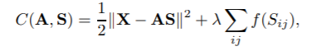
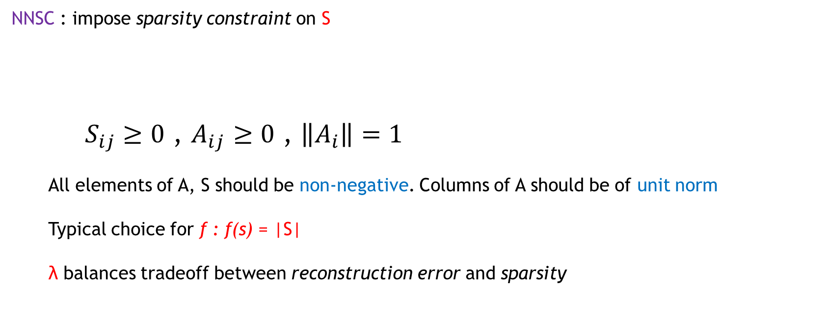
Additional constraints…
NNSC : impose sparsity constraint on S
$S_{ij}≥0$ , $A_{ij}≥0$ , $\left\|A_{i}\right\|=1$
All elements of A, S should be non-negative. Columns of A should be of unit norm
Typical choice for f : f(s) = |S|
λ balances tradeoff between reconstruction error and sparsity
Notes:
We want the hidden components to be sparse. This basically means that any given input vector can be well represented using only a few basis vectors
f controls how sparseness is measured. f typically is a strictly increasing function of the absolute value of its argument
We want the entries of A, S to be non-negative and the columns of A to obey the unit norm constraint.

Slide 12
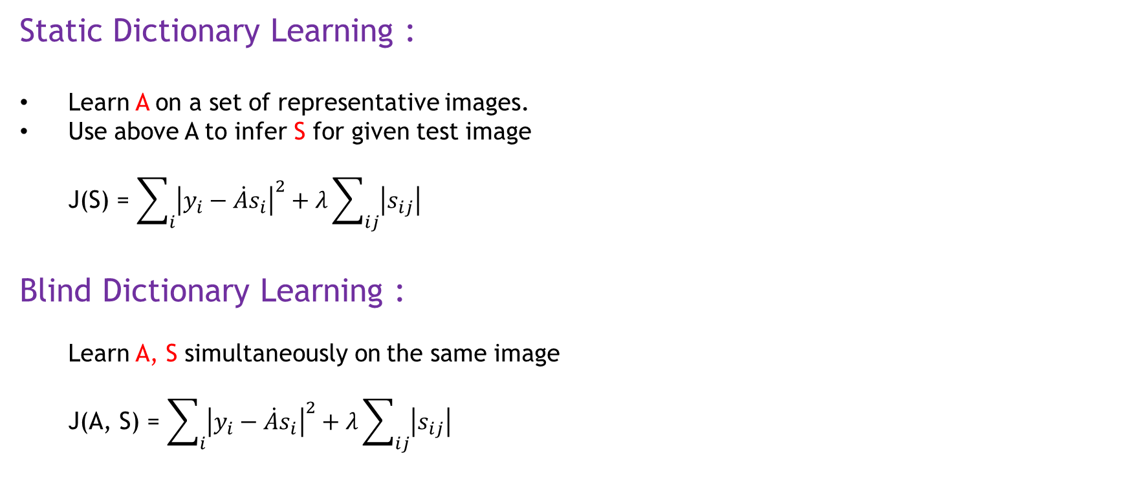
What is Blind Dictionary Learning?
Static Dictionary Learning :
Learn A on a set of representative images.
Use above A to infer S for given test image
J(S) = $\sum_{i}{{\left|y_{i}−\dot{A}s_{i}\right|}^{2}}+λ\sum_{ij}{\left|s_{ij}\right|}$
Blind Dictionary Learning :
Learn A, S simultaneously on the same image
J(A, S) = $\sum_{i}{{\left|y_{i}−\dot{A}s_{i}\right|}^{2}}+λ\sum_{ij}{\left|s_{ij}\right|}$
Notes:
Simply put, we learn both A, S from the input image X.
Sometimes, for static dictionary learning we learn A on a set of representative images, and use that A to infer S for the test image

Slide 13
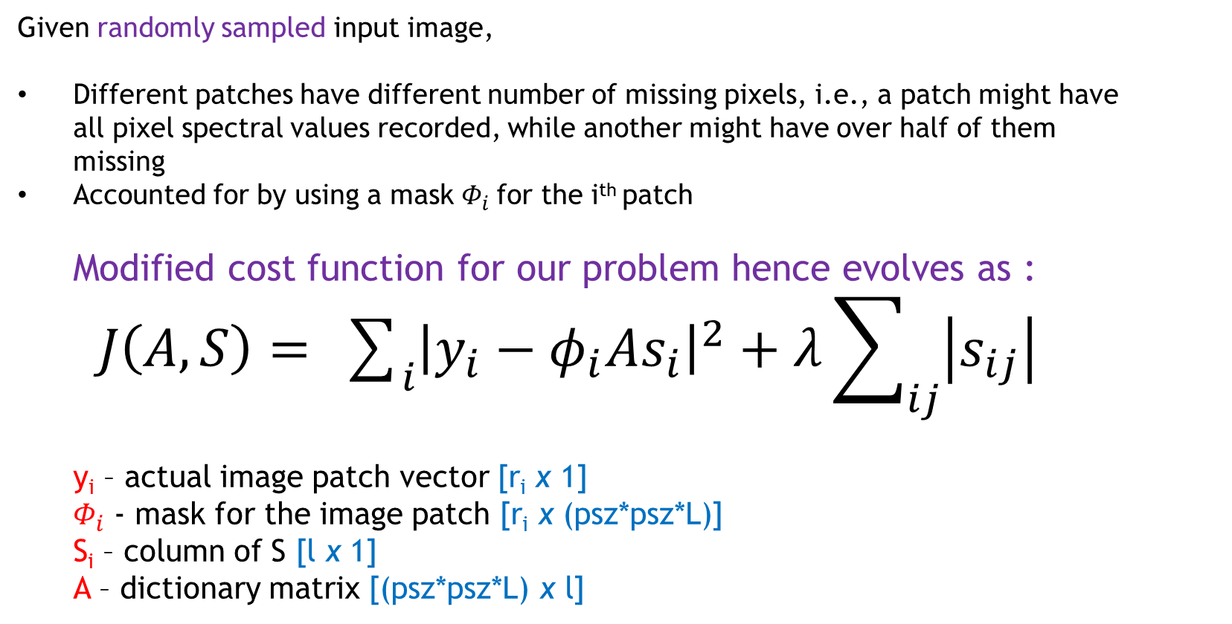
Mask for each patch..
Given randomly sampled input image,
Different patches have different number of missing pixels, i.e., a patch might have all pixel spectral values recorded, while another might have over half of them missing
Accounted for by using a mask $Φ_{i}$for the i^{th} patch
Modified cost function for our problem hence evolves as :
$J\left(A, S\right)= \sum_{i}{{\left|y_{i}−φ_{i}As_{i}\right|}^{2}}+λ\sum_{ij}{\left|s_{ij}\right|}$
y_{i} – actual image patch vector [r_{i} x 1]
$Φ_{i}$ - mask for the image patch [r_{i} x (psz*psz*L)]
S_{i} – column of S [l x 1]
A – dictionary matrix [(psz*psz*L) x l]

Slide 14

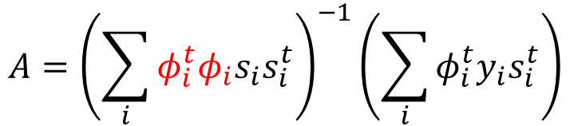
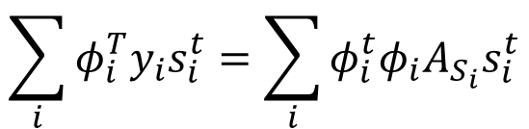
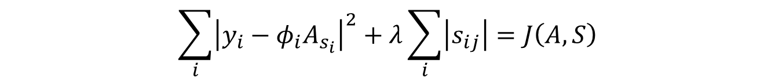
Need for different $φ_{i}^{′}s$
$$\sum_{i}{{\left|y_{i}−φ_{i}A_{s_{i}}\right|}^{2}}+λ\sum_{i}{\left|s_{ij}\right|}=J\left(A,S\right)$$
Differentiating wrt A, we get ,
$$−2φ_{i}^{t}\left(y_{i}−φ_{i}A_{s_{i}}\right)s_{i}^{t}=0$$
$$\sum_{i}{φ_{i}^{T}y_{i}s_{i}^{t}}=\sum_{i}{φ_{i}^{t}φ_{i}A_{S_{i}}s_{i}^{t}}$$
$$A={\left(\sum_{i}{φ_{i}^{t}φ_{i}s_{i}s_{i}^{t}}\right)}^{−1}\left(\sum_{i}{φ_{i}^{t}y_{i}s_{i}^{t}}\right)$$
Notes:
This clearly shows that we do need different phi_i’s for different image patches and also require them to be well-formed.

Slide 15
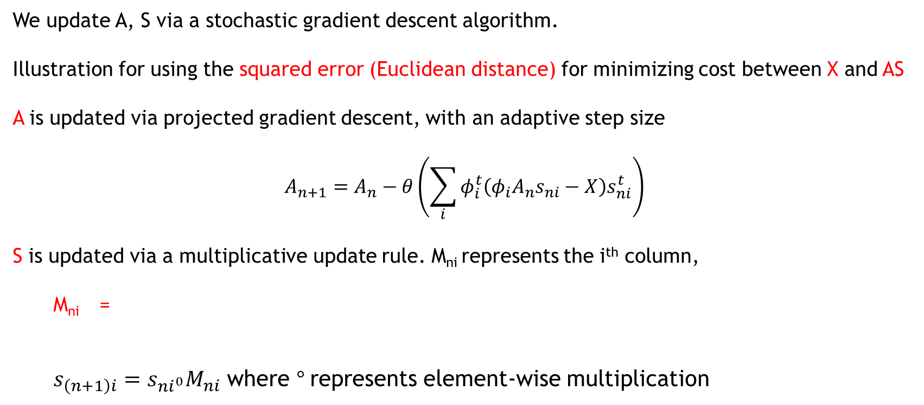
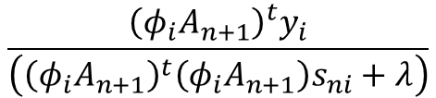
Learning A, S simultaneously
We update A, S via a stochastic gradient descent algorithm.
Illustration for using the squared error (Euclidean distance) for minimizing cost between X and AS
A is updated via projected gradient descent, with an adaptive step size
$$A_{n+1}=A_{n}−θ\left(\sum_{i}{φ_{i}^{t}\left(φ_{i}A_{n}s_{ni}−X\right)s_{ni}^{t}}\right)$$
S is updated via a multiplicative update rule. M_{ni} represents the i^{th} column,
M_{ni} =
$s_{\left(n+1\right)i}=s_{ni^{0}}M_{ni}$ where $°$represents element-wise multiplication
$$\frac{{\left(φ_{i}A_{n+1}\right)}^{t}y_{i}}{\left({\left(φ_{i}A_{n+1}\right)}^{t}\left(φ_{i}A_{n+1}\right)s_{ni}+λ\right)}$$
Notes:
Here theta is the step size.
Can use KL divergence instead of Euclidean distance as well.
Multiplying S by a positive factor, hence it is always positive, and non-increasing

Slide 16
Additional constraints…
We are employing Projected Gradient Descent, so
Any negative entry in A is set to zero
All columns in A are enforced to be of unit norm
→ To maximize sparsity, we can multiply an arbitrarily large value to elements of A, and scale down elements of S by the same factor, which minimizes the overall objective function. However, such a value of A is clearly not desirable
Notes:
Since we enforce A_{i} to be non-negative, hence any negative entry is set to 0. Now to minimize reconstruction error, X – AS, and to maximize sparsity, we can multiply an arbitrarily large value to elements of A, and scale down elements of S by the same factor, which minimizes the overall obj function. However, this does yield a satisfactory value of A post convergence, and hence we impose a unit norm constraint on the columns of A

Slide 17
Results..
Image of an emulsion (60 X 60 X 253) corrupted with Poisson noise of varying levels
Image of emulsion (60 X 60 X 253) with different sampling rates of 20%, 50% and 80%
Image of Aspirin tablet (20 X 20 X 201) with different sampling rates of 20%, 50% and 80%
Silicon wafer image (71 X 71 X 201) with different sampling rates of 20%, 50% and 80%
Silicon wafer image (101 X 101 X 201) with different sampling rates of 20%, 50% and 80%
Silicon wafer image (41 X 41 X 201) with different sampling rates of 20%, 50% and 80%
Synthetic data with different sampling rates of 20%, 50% and 80% (Using Radial basis function)
Synthetic data with different sampling rates of 20%, 50% and 80% (preservation of edges)
Hyperspectral images of two sceneries with 20%, 50% and 80% sampling rates

Slide 18
Future Work
Implement deep neural networks for the problem of inpainting
Make it more robust against varying degrees of Poisson noise, which is most dominant form of noise
Acquire more Raman spectral images for testing purposes
Spectral Separation : Observing a Raman image of paracetamol and caffeine mixture, and given representative paracetamol signatures, determine the fraction of caffeine in the sample
Super-resolution : Skip every second pixel to get a lower resolution image, and then super-resolve using one of many different possible methods
Notes:
2) More robust by testing on more images
4) Learn a dictionary for the paracetamol + caffeine subspace as well as for pure paracetamol subspace, and then try to get the dictionary for the caffeine subspace

Slide 19
THANK YOU

